Slide 1
Capstone Project The Battle of Neighborhood
New York City Travel and Restaurant Investments Recommender

Slide 2
Introduction/Problem
New York City (NYC), often called simply New York, is the most populous city in the United States. With an estimated 2019 population of 8,336,817 distributed over about 302.6 square miles, New York City is also the most densely populated major city in the United States.
Located at the southern tip of the U.S. state of New York, the city is the center of the New York metropolitan area, the largest metropolitan area in the world by urban landmass. With almost 20 million people in its metropolitan statistical area and approximately 23 million in its combined statistical area, it is one of the world's most populous megacities.
Situated on one of the world's largest natural harbors, New York City is composed of five boroughs, each of which is a county of the State of New York. The five boroughs—Brooklyn, Queens, Manhattan, the Bronx, and Staten. The city and its metropolitan area constitute the premier gateway for legal immigration to the United States. As many as 800 languages are spoken in New York, making it the most linguistically diverse city in the world. New York is home to more than 3.2 million residents born outside the United States, the largest foreign-born population of any city in the world as of 2016. As of 2019, the New York metropolitan area is estimated to produce a gross metropolitan product (GMP) of $2.0 trillion. (Reference: Wikipedia)

Slide 3
Problem Description
The objective of this capstone project is not only to analyze/select the best locations in the city of New York for tourists, but also to give suggestions to those who want to open a new restaurant in New York City, based on the data of different neighborhoods in the city.
Based on the above info, we will answer three questions below:
1. What the most visited venues in New York City?
2. Which neighborhood has the most venues?
3. What the best investment choices in New York City if someone wants to open a restaurant?
By answering the above three questions, it will help tourists or investors to know what place is better to visit, invest, or to start their own business based on the venues’ information. This will also help people to make decisions if they are thinking about migrating to New York City. In short, the target for this project is basically everyone who is exploring different places or similar places.

Slide 4
Description of the Data
The main data that will use in the project is from below link: https://maps.princeton.edu/catalog/nyu-2451-34572.
We will use the below data:
1. List of neighborhoods in New York City.
2.Latitude and longitude coordinates of those neighborhoods
3. Specific venue data and mainly related to restaurants
Then we will use Foursquare API to explore the data for those neighborhoods. Overall, this project will involve data cleaning, data wrangling, machine learning, and data visualization.

Slide 5
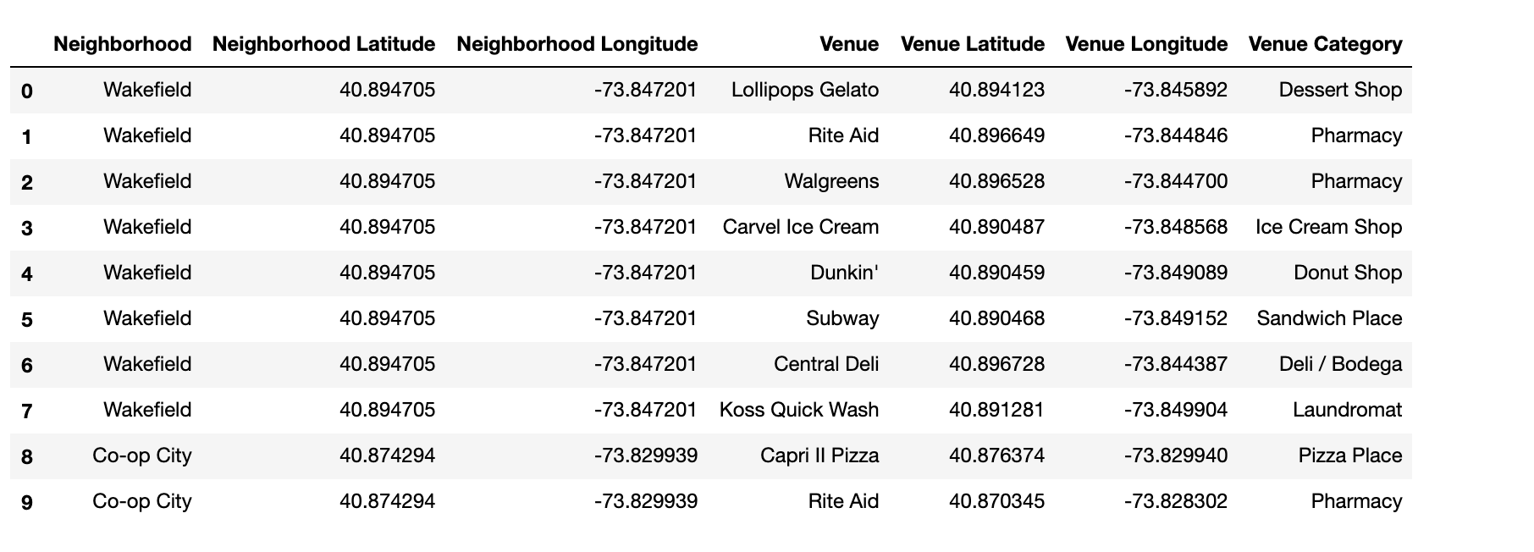
Data We Need

Slide 6
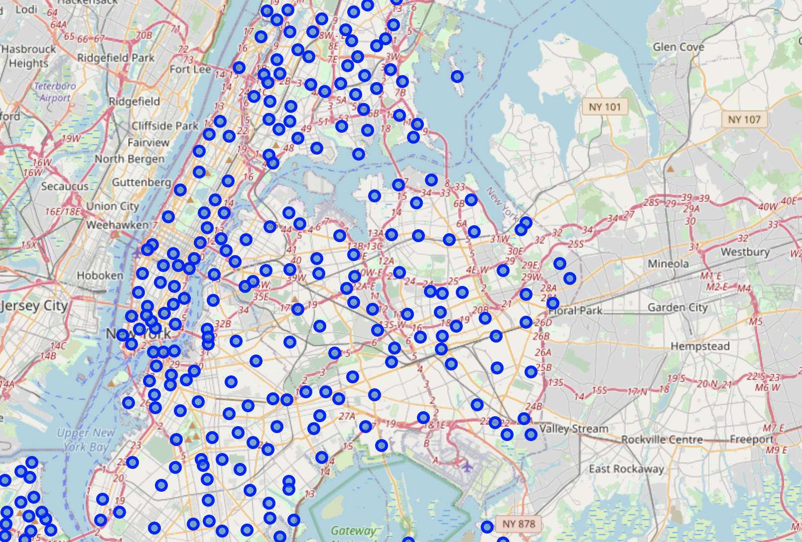
Use Folium to visualize the data

Slide 7
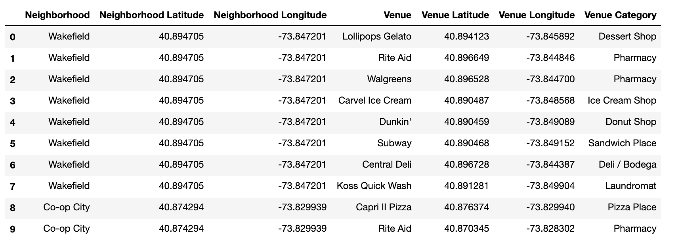
Implement Foursquare API to explore

Slide 8
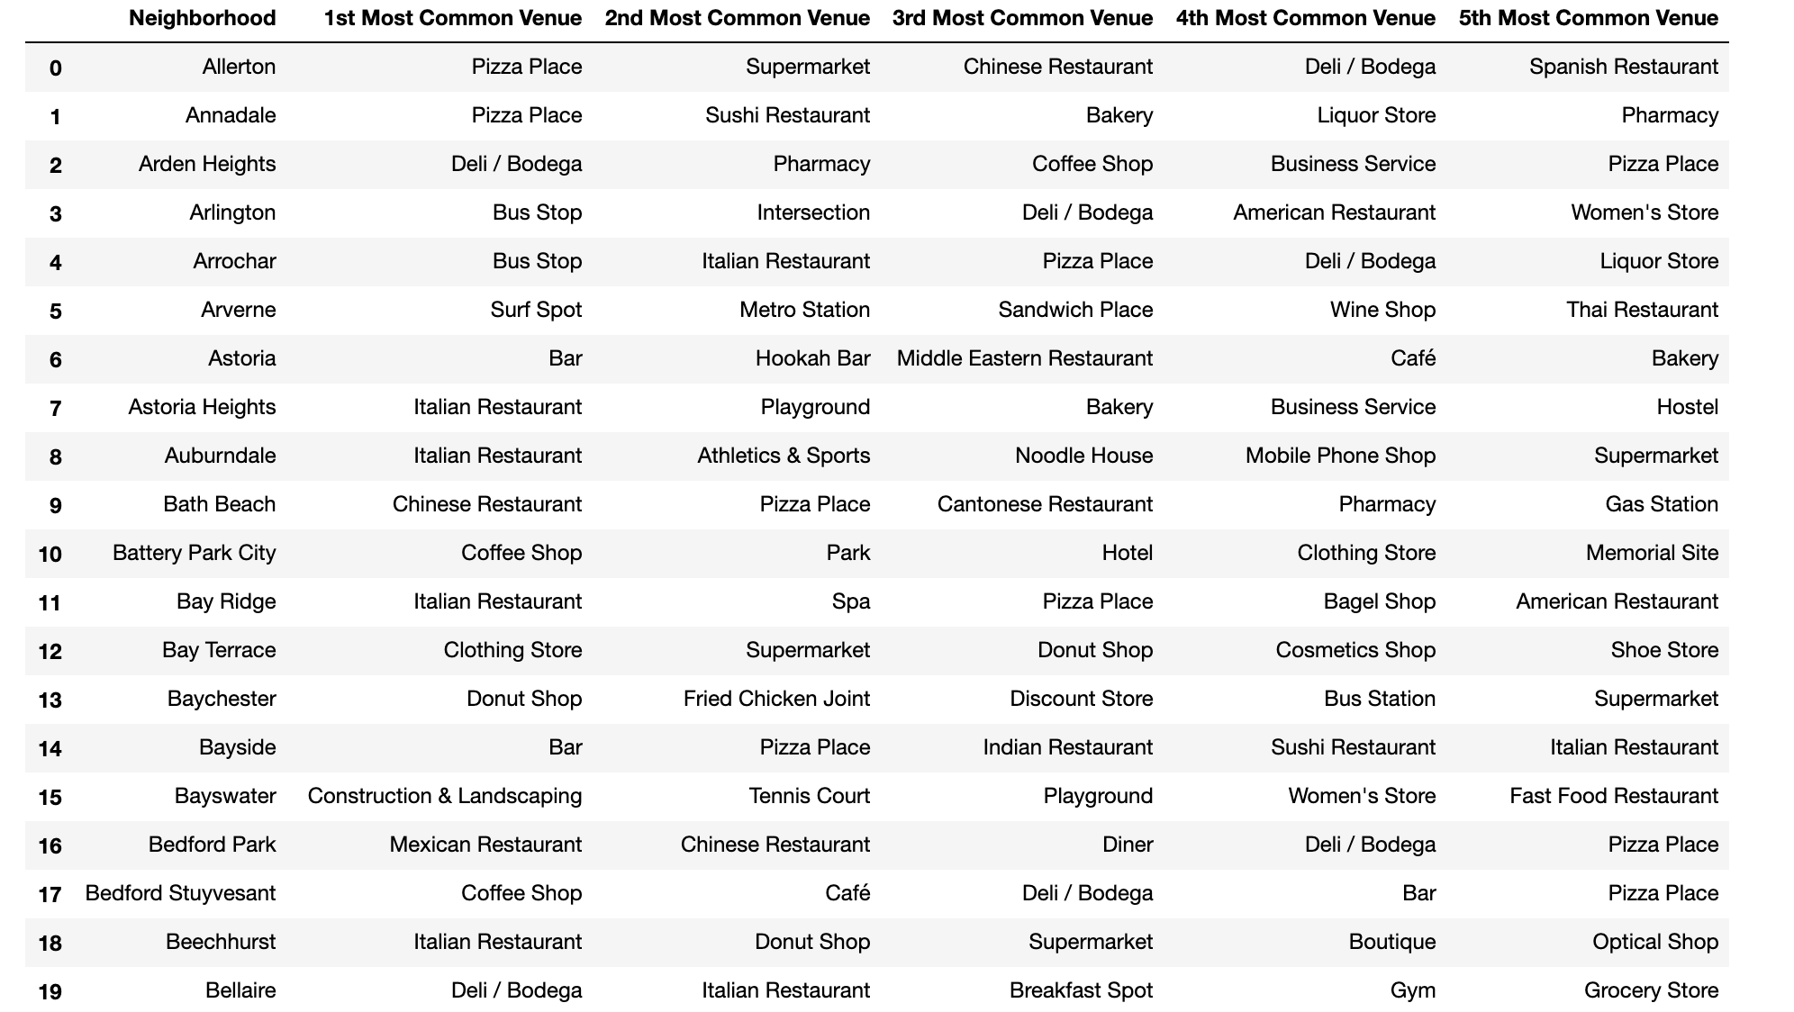
Collect the the most common venues from each neighborhood

Slide 9
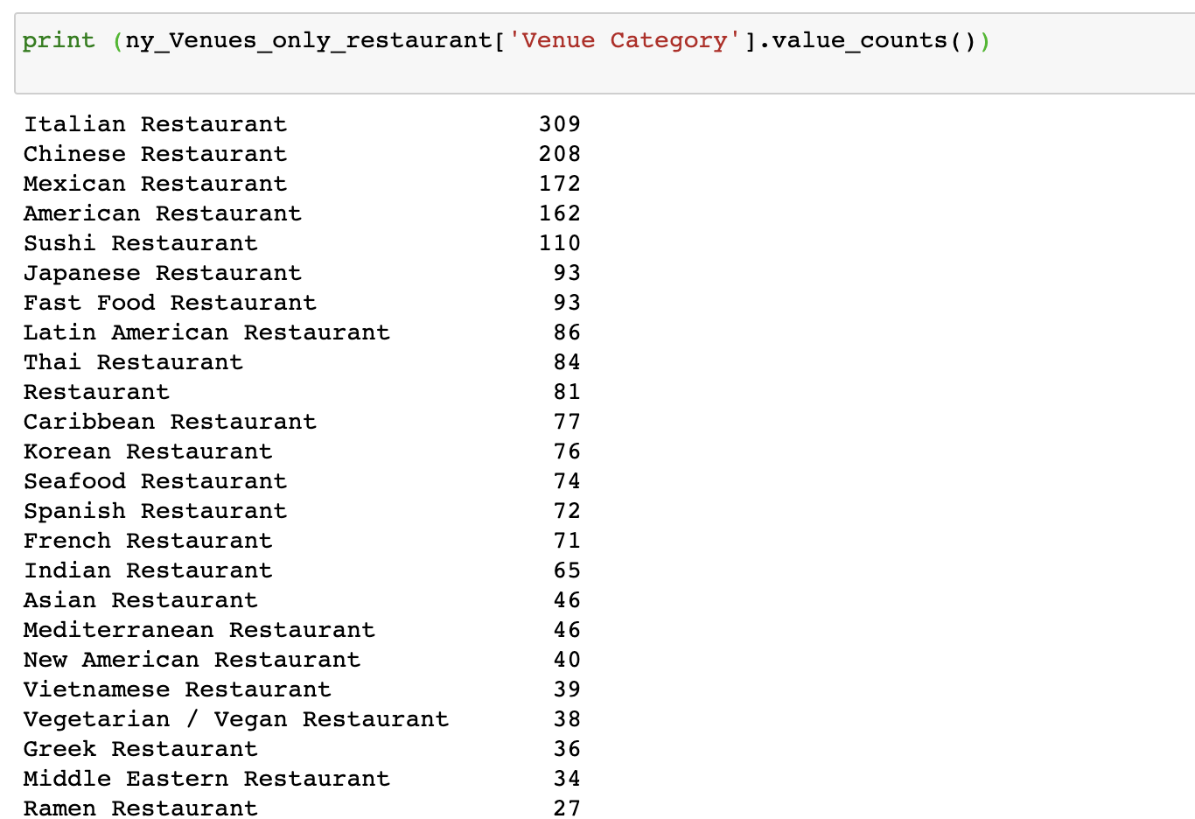
Limit the data to restaurants related

Slide 10
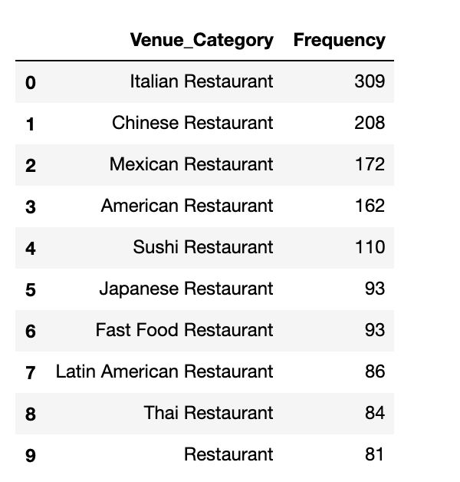
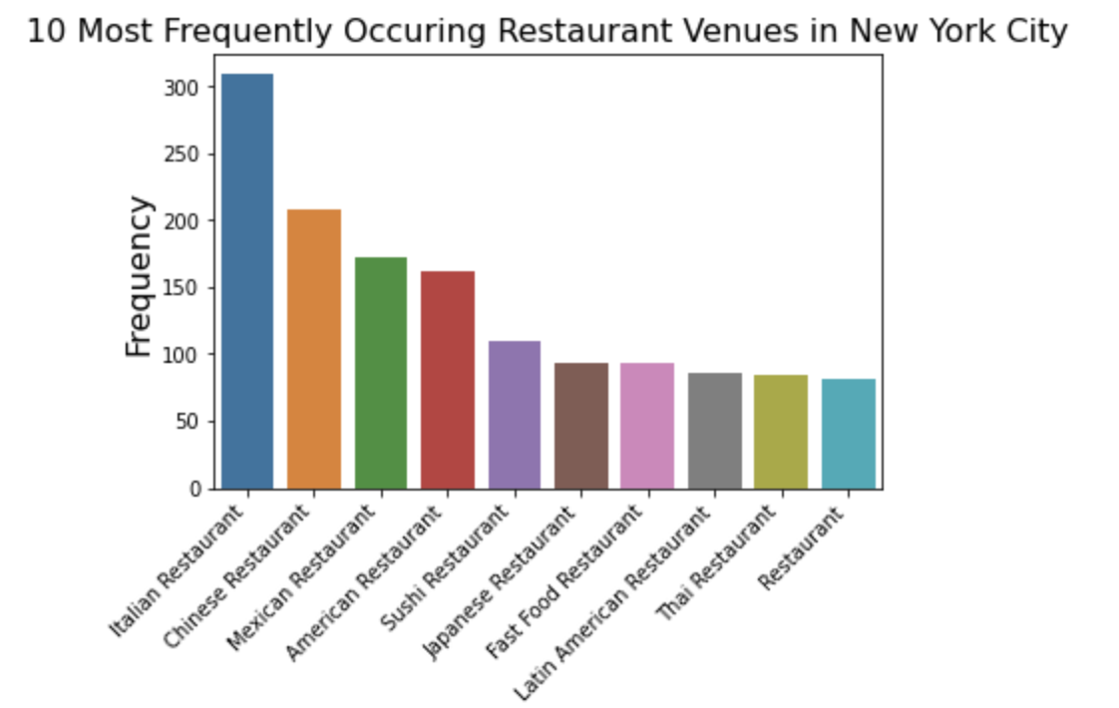
Visualize the top 10 restaurants categories

Slide 11
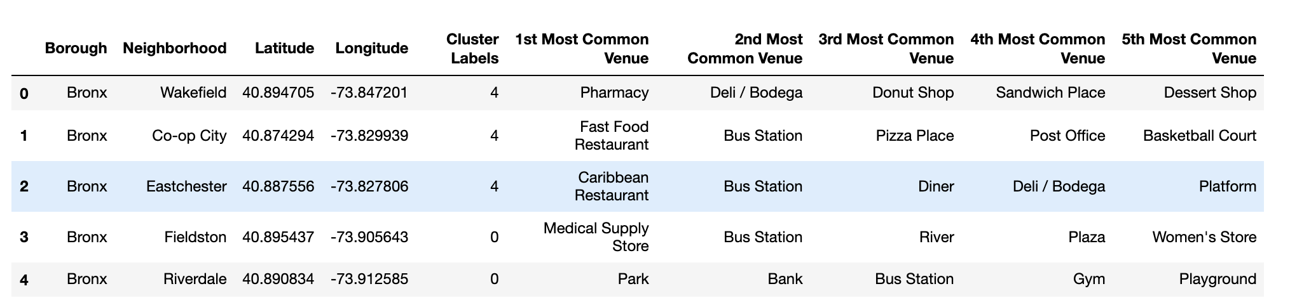
Methodology Group the neighborhoods into to different clusters by applying clusters K-means algorithm

Slide 12
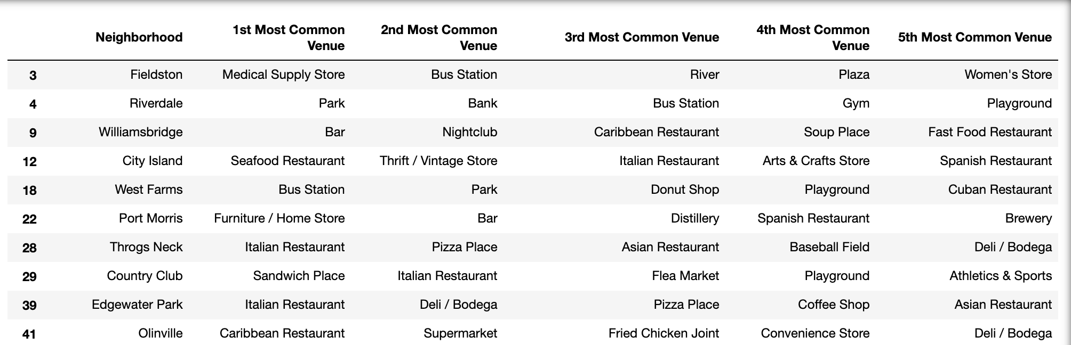
Results – part 1

Slide 13
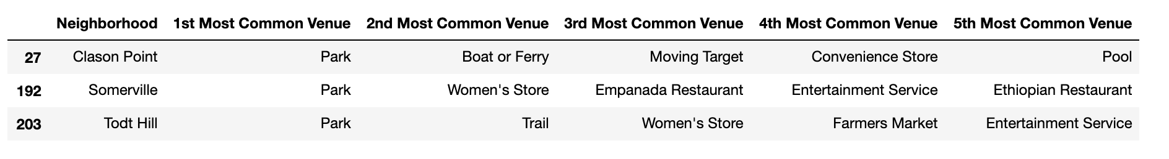
Results – part 2

Slide 14
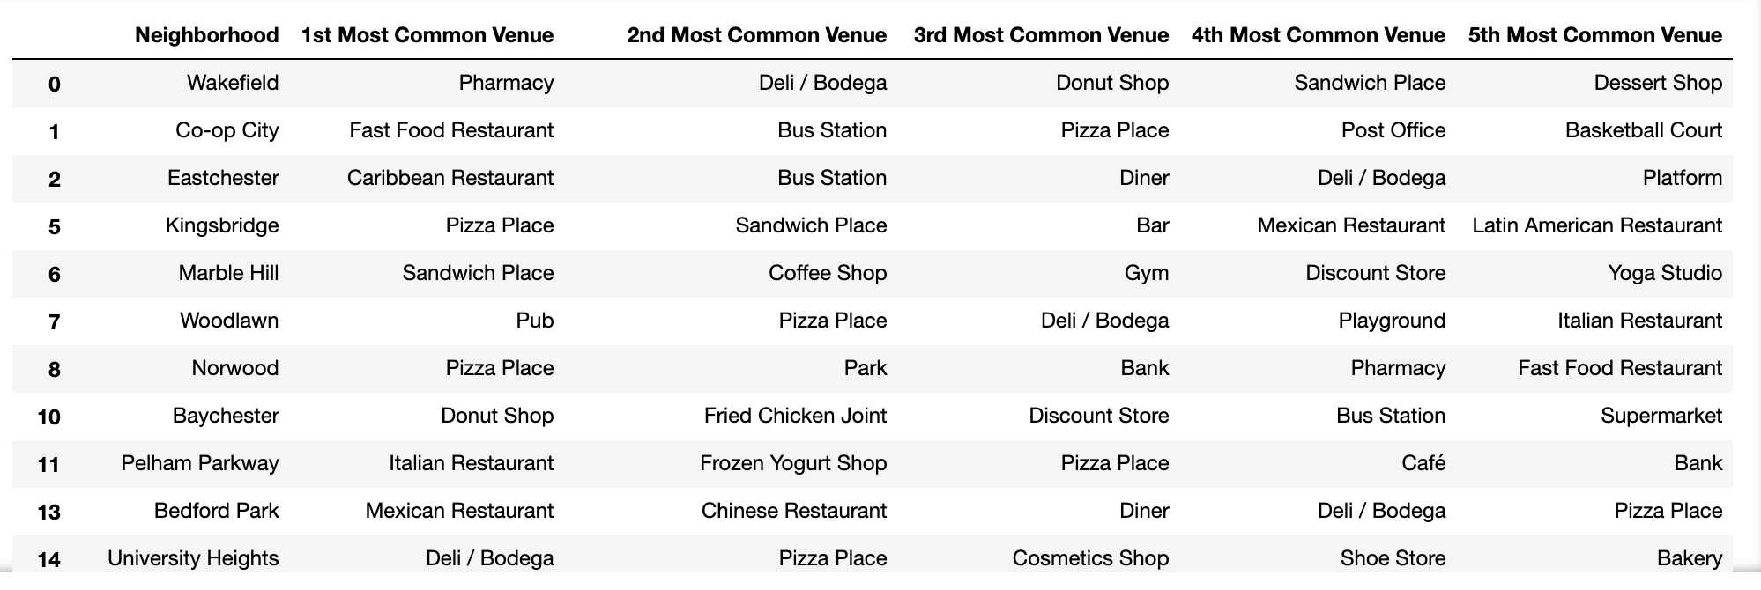
Results – part 3

Slide 15
Discussion/Conclusion
Overall New York City is a diverse city. Based on the data above,
Italian Restaurant, Coffee shop, Pizza Place are the most common restaurants in the city.
On the other hand, there are a few interesting things:
1. In neighborhood 'Wingate‘, 'Holliswood', and 'New Lots' , it seems like people really love fried chicken
2. Boba tea shop is the most common venue in neighborhood 'Whitestone’
3. Indian restaurants are the most common restaurant in neighborhood 'Floral Park’
In conclusion, this project involved lots of data cleaning, data wrangling, machine learning, and data visualization. By using these data, it can help potential business owners to make decisions on which locations they can invest in.

